Slide 1



“ BLOGGING WEBSITE”
Task - 1

Slide 2


SUNSTONE
Project Name : “ BLOGGING WEBSITE ”
An blogging website is basically a informative website it holds many important and informative contents. And the user can easily handle the website they can post , comment, read and like the content they like.
S.NO | LMS Username | Name | Batch
1 | @yuvarajooo1 | Yuvaraj.S | 1
2 | @Pavi06thra | Pavithra.M | 1
3 | @mageshwariperumal | Mageshwari.P | 1
4 | @Jeevi58 | Jeevitha.G | 1

Slide 3
SUNSTONE
Task-1
Creation of SRS & Github
Create SRS : “Blogging website”
Creation & A Set-up of Github account
Creation & Hands – on to various commands of Git Bash
Evaluation Metric:
100% Completion of the above tasks
Learning Outcome
Get to know about different lifecycle models.
Understanding importance and how to create an SRS.
Knowing various commands of Github.
Understanding agile and scrum management techniques for efficient for product development.

Slide 4
SUNSTONE
STEP WISE DESCRIPTION
Define Your Niche and Purpose
Choose a Theme
Create Essential Pages
Configure SEO Settings
Design and Customize
Regularly Update and Maintain
Install Essential Plugins
Set Up a Content Management System (CMS)
Design and Customize:

Slide 5
SUMMARY
The purpose of a blogging website is to provide a platform for individuals or organizations to share information, insights, and experiences on a specific topic or range of topics. It serves as a medium for communication, education, and entertainment, allowing authors to connect with an audience, express their ideas, and potentially generate revenue through various monetization strategies. Additionally, a blogging website can establish authority in a niche, foster a sense of community, and contribute to personal or brand development.

Slide 6
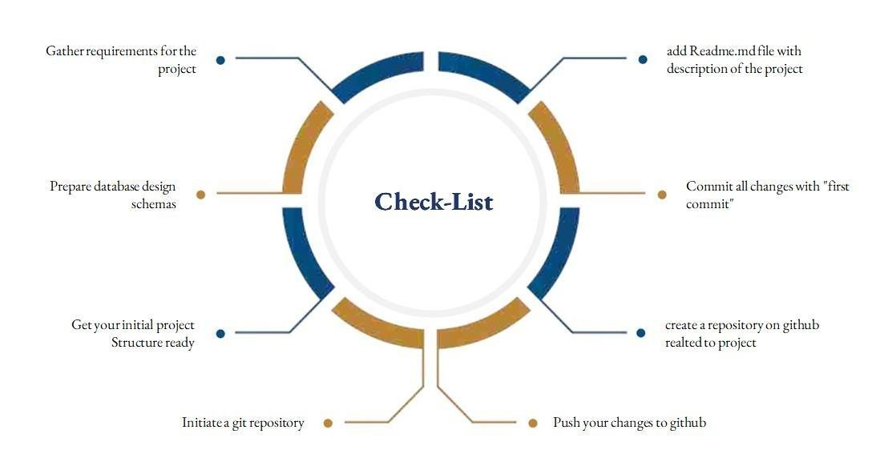
SUNSTONE
Assesment Parameter

Slide 7
Submission Github
SUNSTONE
https://github.com/yuvarajooo1/NM-AIT-GROUP1

Slide 8


SUNSTONE

